Slide 1
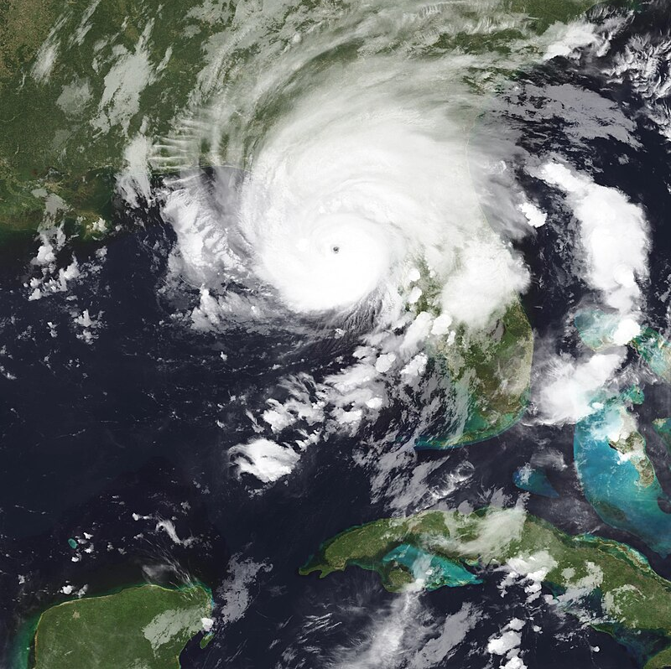
Hurricane Idalia Evacuation & Response- Lessons Learned
GOES-16 Geocolor Image of Hurricane Idalia at 0715 UTC 30 August 2023 Courtesy of NOAA/NESDIR/STAR
Notes:
Idalia was a category 4 hurricane (on the Saffir Simpson Hurricane Wind Scale) that rapidly intensified over the Gulf of Mexico. It made landfall as a category 3 hurricane along the Florida Big Bend and is the third strongest landfalling hurricane in modern history for that region.

Slide 2
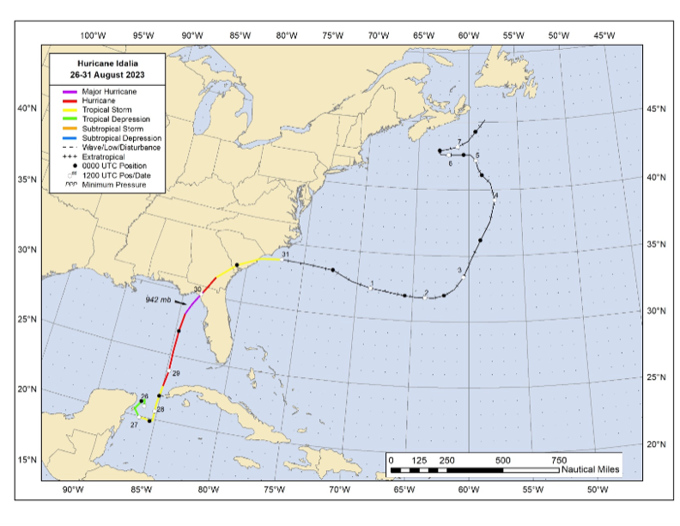
Idalia – Storm Summary
Storm Surge: 8 -12 Feet above ground level from Keaton Bch to Steinhatchee, FL
Rainfall Totals: 5 – 7 inches with pockets up to 7-10 inches
Tornadoes – 12 total over FL, GA, SC and NC
Fatalities – 12, 8 caused by rough surf & rip currents
Source: National Hurricane Center Tropical Cyclone Report, Hurricane Idalia, February 2024
John P Cangialosi and Laura Alaka
Notes:
It originated in the far eastern Pacific Ocean, as an area of showers and thunderstorms on 23 August.
By August 27, the depression strengthened into Tropical Storm Idalia.
It became a hurricane as it entered the far southeastern Gulf on 29 August, and began to rapidly intensify while accelerating toward the north and north-northeast.
By early August 30 Idalia became a major hurricane and data from the Air Force Hurricane Hunters indicate that it became a 115-kt category 4 hurricane when the center was approaching the Florida Big Bend region, about 80 n mi south of Tallahassee (cover image)
Very shortly after attaining category 4 status, data showed that the eye feature had become a little less defined, and that the winds had decreased some while the central pressure rose several millibars. This weakening was likely due to an eyewall replacement cycle that began just after the hurricane reached its peak intensity
Here’s a summary of the impacts Idalia caused. It caused an estimated $3.6 billion in damage in the U.S.

Slide 3
Panelists
John MacDonald – Levy County
Scott Garner- Dixie County
Shayne Morgan - Columbia County
Source: FEMA
Notes:
Introduce panelists. What main topics to cover:
Here are the main discussion panel points:
Evacuation/Decision Making – were the evacuation studies used to assist in decision making? What were your evacuation times? Did you issue evacuation orders/notices? What decision support tools did you use? What resources were used to notify threatened areas?
Sheltering Issues, both coastal and inland(Shayne to discuss being both a risk and host sheltering location).
Debris contracting issues, debris disposal issues (not picking up debris at pre identified/approved drop off sites)
Volunteer/Donation issues.

