Slide 1
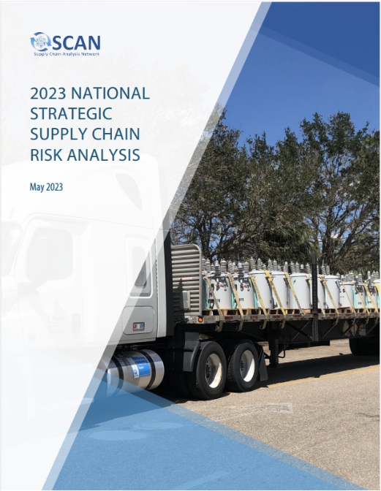
Supply Chain Analysis Network History and Purpose
National Hurricane Conference 2024
Kathy Fulton
Executive Director
American Logistics Aid Network
Jason McNamara
Director, Center for Emergency Management Operations
CNA Corporation
March 26, 2024
1:30 – 3 PM

Slide 2
Why SCAN?
The problem: Critical commodity (food, water, fuel) supply chains are essential to business and consumers everyday, but during a disaster, survivors’ ability to access these commodities are what separates a disaster from a catastrophe.
Government can’t provide these commodities at scale; private sector is essential
Government can mess things up or facilitate recovery of supply chains; need to know where/how to help or get out of the way
The need: FEMA, and especially the Logistics Management Directorate (LMD) – the ones that move all the FEMA stuff – needs actionable, timely intelligence on private sector supply chain status to inform its own operations and share information within the entire inter-agency emergency response enterprise.

Slide 3
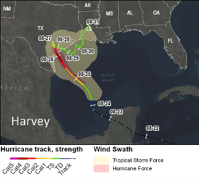
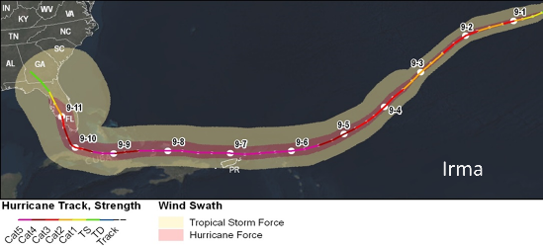
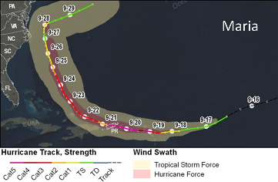
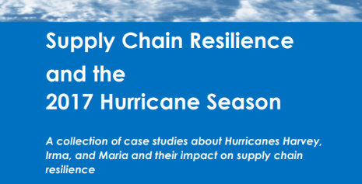
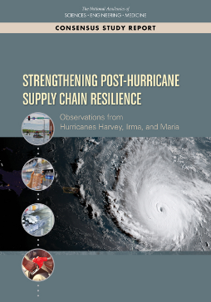
Origin Story
Supply Chain resilience work – Palin et al. ~ 2016 (Los Angeles area)
2017 Hurricane Season
NASEM 2017 Hurricane Season After-Action
CNA study “Supply Chain Resilience and the 2017 Hurricane Season” https://www.cna.org/archive/research/hurricane-supply-chain
NASEM Consensus Report - https://nap.nationalacademies.org/catalog/25490/strengthening-post-hurricane-supply-chain-resilience-observations-from-hurricanes-harvey
A few people get to talking…
FEMA LMD funds SCAN through Dewberry Engineers’ Logistics Construction Support Contract (LCSC)
Dewberry brings on CNA, MIT, ALAN and others as subs

Slide 4
Who is SCAN?
CNA
Jason McNamara
Analysts
SMEs
Kathy Fulton
Phil Palin
MIT
Jarrod Goentzel
Lauren Finegan
Dewberry Engineers
Joe Goetz
Managers
Analysts
Contractors
Tim Russell

Slide 5
Team roles
Ecosystem Team
Lifeline Team
Support
(Daily) Ecosystem brief
Management
Monitor HUMINT/SIGINT
Hypothesis generation
Information sharing
Lifelines Assessment Briefings
Monitor data networks and acquire HumInt
Share analysis and derived products
Coordination
Monitoring event status and coordination calls
Data processing, visualization, sharing
GIS and Mapping
Other support as needed
Contract oversight
Staffing
Setting short/medium term priorities
Deliverables management
Activity tracking
Integration into ecosystem/ lifeline teams
Lifeline deep dives
Communications
Traffic Team
Ports and Intermodal
Electric Power
Monitor traffic and communications
Monitor conditions at ports, rail, airports
Monitor status of power systems
Monitor Truck Stops and Rest Areas, Bridges, etc.
Contribute to Lifelines Assessment Briefings
Talk to port operators
Talk to folks in industry
Contracted capability through Dewberry
Added more recently…

Slide 6
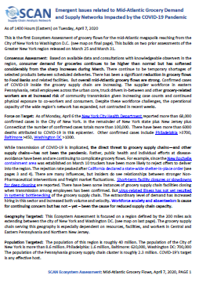
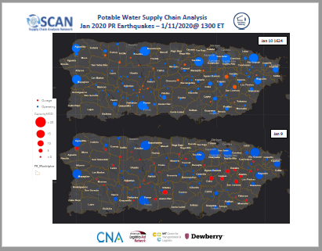
What does SCAN do?
SCAN is intended to answer two questions:
Are key demand and supply networks failing?
If so, when, where, why, and with whom can FEMA engage to be most effective in reversing failure?
Blue sky work
Supply chain baseline assessment in preparation for FEMA/Regional exercises
National Fuel Ecosystem Assessment
Strategic Assessments
Hurricane Season prep for the Administrator
Activations
Lifelines Briefing
Lifelines Assessment
Ecosystem Assessment

Slide 7
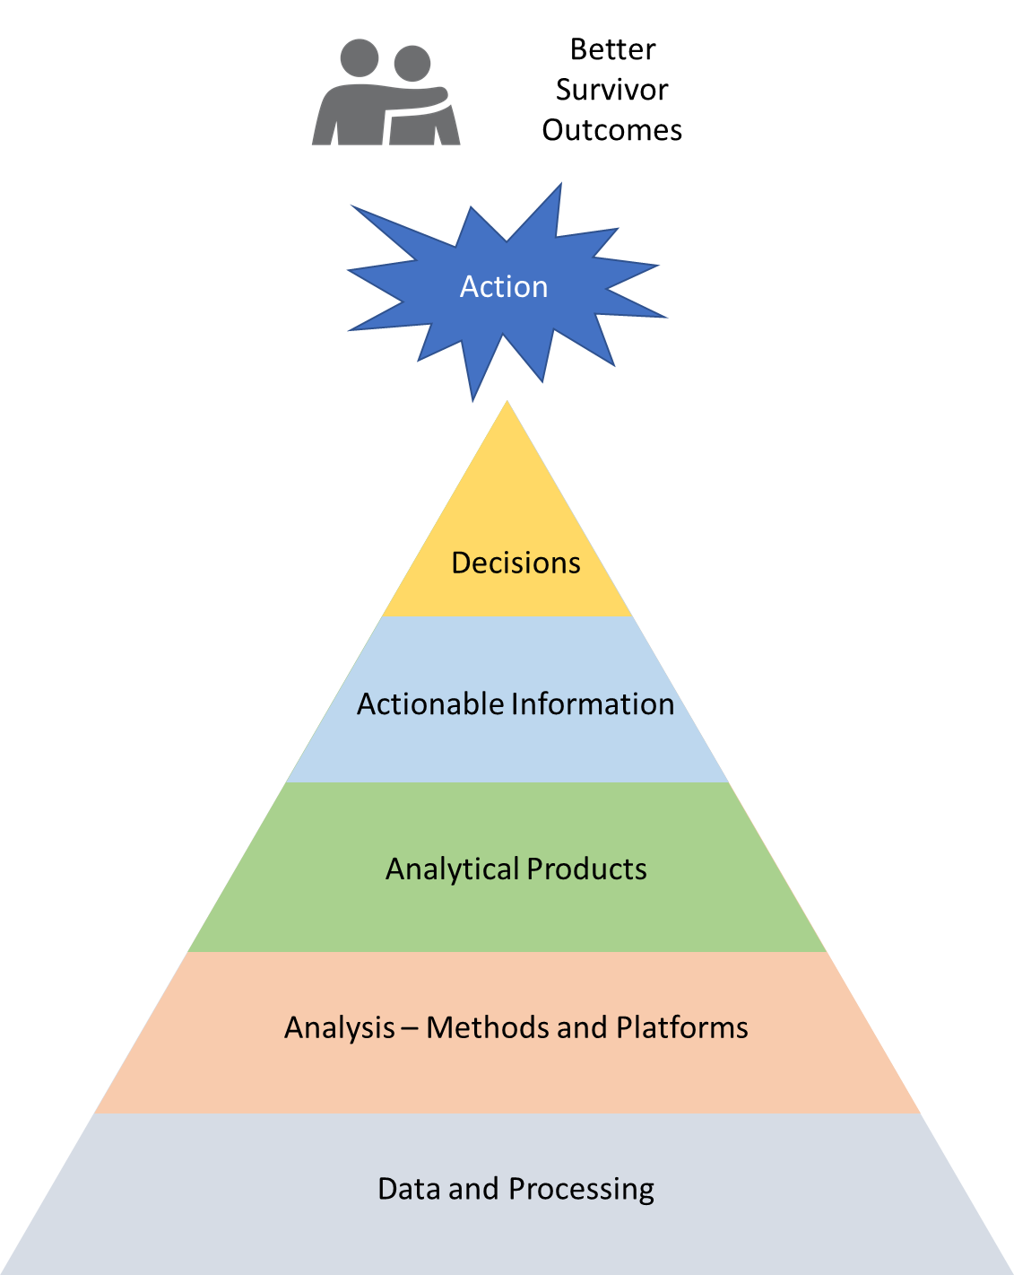
Working toward the end goal
Ultimate goal is better outcomes for survivors
Data-informed analysis leads to actionable information to support decisions that influence action
Effort involved is highest at the bottom of pyramid (notably, data processing)

Slide 8
SCAN Activations
 | Event | Areas Affected | Dates
 | TS Erick and Flossie | Hawaii | Aug 2019
 | Invest 96L | Puerto Rico, USVI | Aug 2019
 | Hurricane Dorian | PR, FL, GA, SC, NC, VA | Aug – Sep 2019
 | Puerto Rico Earthquake Swarm | Puerto Rico | Jan 2020
 | COVID-19 | Whole US | Jan – Jul 2020
 | Hurricanes Marco, Laura | LA, TX | Aug-Sep 2020
 | Hurricane Delta | Louisiana | Oct 2020
 | Hurricane Henri | CT, RI, MA, NH | Aug 2021
 | Hurricane Ida |  | Aug-Sep 2021
 | Hurricanes Fiona, Ian | PR, FL, SC | Sep – Oct 2022
 | Hurricane Idalia | FL, GA, SC | Aug- Sep 2023

Slide 9
SCAN Blue Sky Analysis
 | Project | Areas Affected | Dates
I/II | Blue Sky I, II -SCAN Organization, CONOPS | N/A | 2019
 | Blue Sky III – Great Salt Shake (UT) | Greater Salt Lake City, UT area | 2020
 | Blue Sky IV – Cascadia Rising 2022 | WA, OR | 2021-2022
 | Blue Sky V – Pacific OCONUS | AK, HI, Guam, CNMI, American Samoa | 2023
 | National Fuel Ecosystem Assessment | US (esp. Mid-Atlantic, Gulf coast) | 2021
 | National Strategic Supply Chain Resilience Assessment – 2022 Hurricane Season | US, (esp. SE states) | 2022
 | National Strategic Supply Chain Resilience Assessment – 2023 Hurricane Season | US, (esp. SE states) | 2023

Slide 10
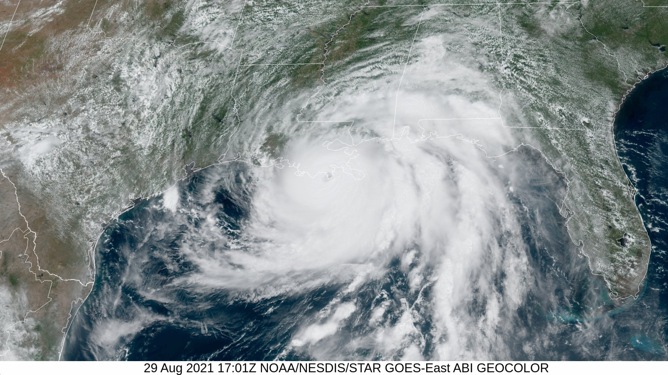
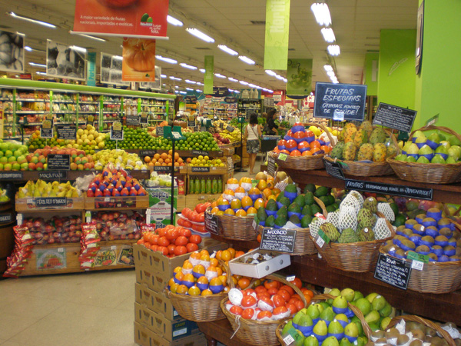
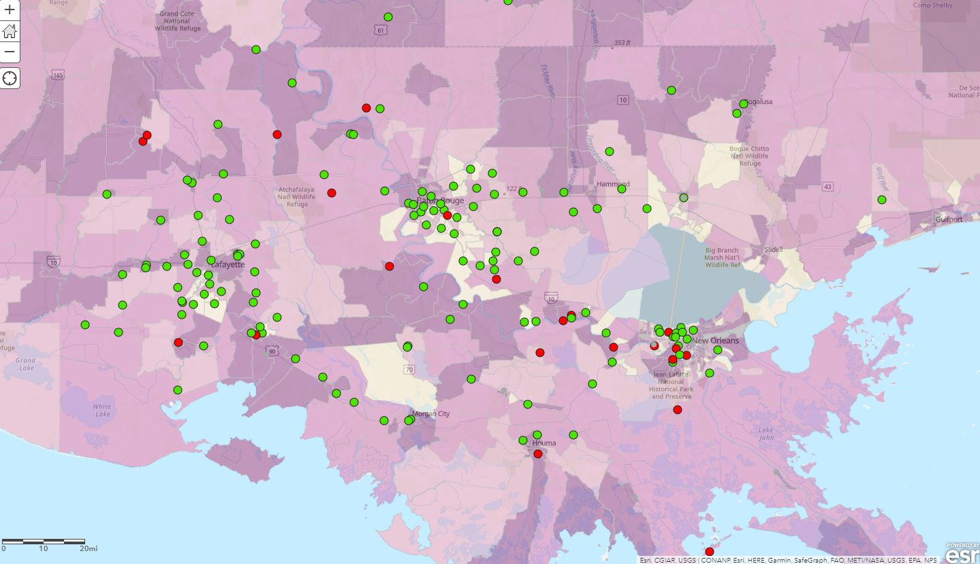
What does SUCCESS look like?
Hurricane Ida
From: ….
Sent: Tuesday, September 7, 2021 3:32 PM
To: ….@fema.dhs.gov>
Cc: Subject: Estimate of Current Grocery Flows in Southeast Louisiana
The grocery sector has shown very substantial recovery since Tuesday, August 31. For example, Walmart is the market-leader for groceries in the region with up to 40 percent market share. As of 1300 on Tuesday, September 7, only five Walmarts have not opened, down from over 100 one week ago. These are shown on the enclosed map.
Rouses Markets is the premier banner served by Associated Wholesale Grocers distributing to about one-fifth of the region's grocery consumers. All Rouses stores, even in hard hit Houma and Golden Meadow, have been open since late last week.
C&S Wholesale Grocers supplies Winn-Dixie, another banner with twenty-nine stores in South Louisiana, among others. C&S has been fully operational at its Distribution Center since the day-after landfall. All Winn-Dixie stores reopened last week. C&S Wholesale Grocers supplies up to 15 percent of grocery consumption in the region.
The fourth market leading grocery distributor is Associated Grocers. They serve more than 200 "independent" grocers across South Louisiana with about 10 percent of the regional market. The pace of recovery was a bit slower for roughly one-third of these retailers. But the vast majority are now open, as shown on the enclosed map.
vs
(as of September 7)
Red closed, Green open

Slide 11
Private Sector Role (Sentinels)
SCAN
Conduct Analysis
Sentinels
Confirm or Correct Hypotheses
Enhance Situational Awareness
SCAN
Compile Synthesis
Recommend Action
Generate Hypotheses

Slide 12
Questions/Discussion

