Slide 1
The Future of Community Readiness
Locally-Rooted Community Preparedness
Notes:
The condition in which in any community is found post-impact has everything to do with community preparedness. Oftentimes this is reduced to a binary… prepared/unprepared, resilient/vulnerable… but this overlooks the complexity and nuance of what makes up a resilient community and who’s involved. Before we dive into the topic, though, let me tell you a bit about who I am, and introduce you to our panel.

Slide 2
Moderator
Meaghan Enright
Executive Director
Love City Strong
Notes:
First, my name is Meaghan Enright, and I’m the Executive Director of an organization called Love City Strong. We’re based on the island of St John, in the U.S. Virgin Islands. The organization was born out of the impacts of Hurricanes Irma and Maria in 2017, and over the past six (nearly seven) years, we’ve been serving our community in the areas of disaster preparedness, response, recovery, and mitigation.

Slide 3
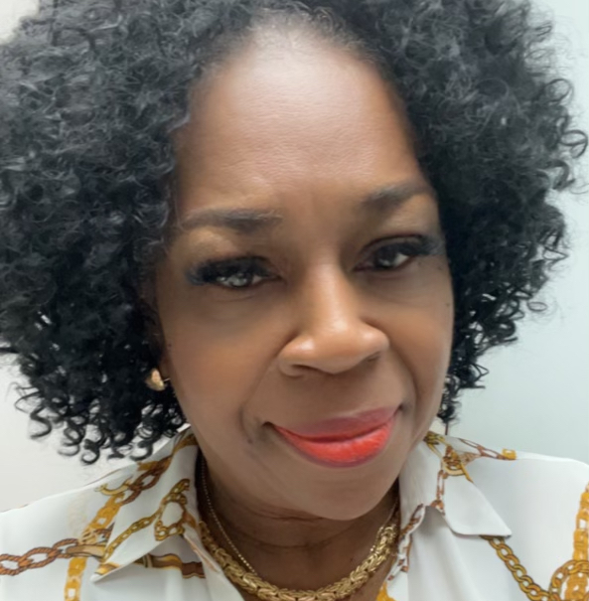
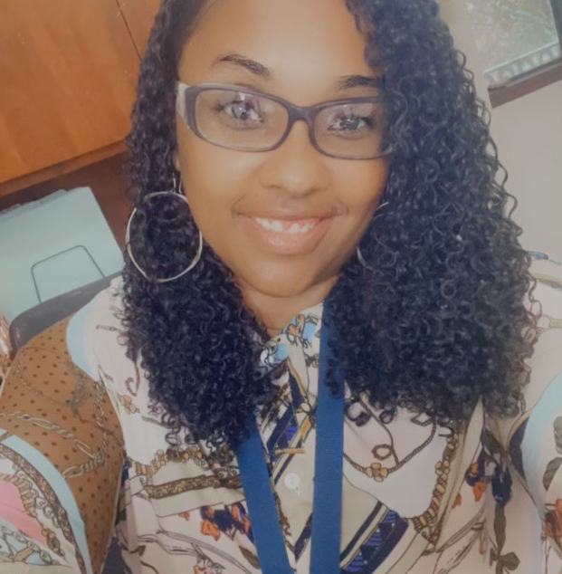
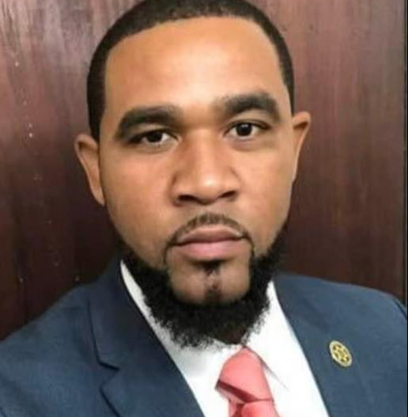
Yvette Henry
Regina Browne
Delia Richardson
Wilbur Francis
Panelist
Panelist
Panelist
Panelist
Community Affairs Coordinator
V.I. Department of Human Services
Deputy Director of Planning & Preparedness
VITEMA
Executive Director
Virgin Islands VOAD
Director of Enforcement
VI Department of Licensing and Consumer Affairs
Notes:
Today our panel consists of several colleagues I have the pleasure of working with regularly in the USVI, encompassing the government, nonprofit, and private sectors. (Introduce in order of seating)

Slide 4
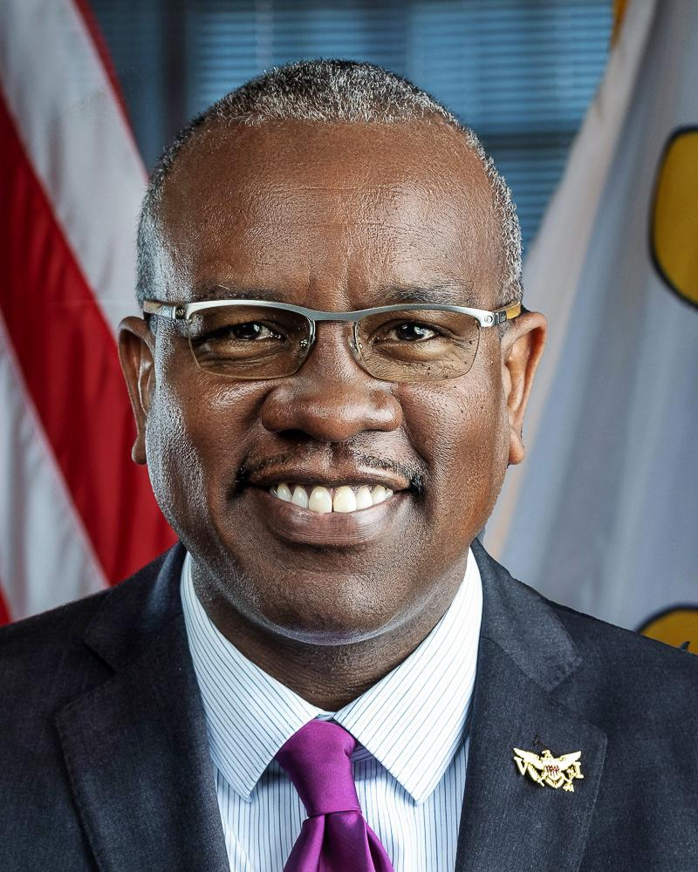
Governor Albert Bryan, Jr.
Lieutenant Governor Tregenza Roach
Notes:
Several of my colleagues here on the panel are representing the Government of the Virgin Islands, which is led by our Governor, Albert Bryan, Jr and our Lieutenant Governor, Tregenza Roach.

Slide 5
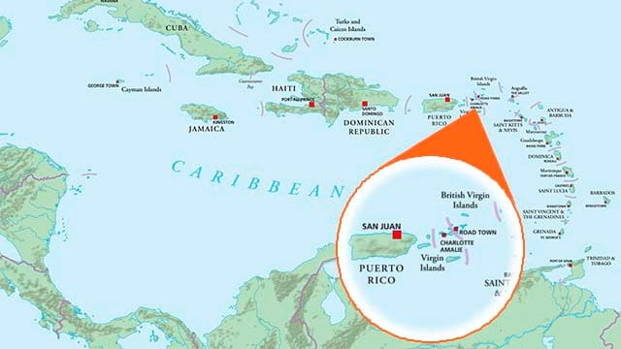
Where is the USVI?
The U.S. Virgin Islands is a territory of the United States located in the Leeward Islands of the Lesser Antilles, east of Puerto Rico.
The territory consists of three main islands, St Croix, St John, and St Thomas, along with many smaller islands and islets.
As residents of a remote island territory situated in a region susceptible to tropical cyclones, community readiness is incredibly important for Virgin Islanders.
In 2017, the territory was hit by Category 5 Hurricanes Irma and Maria within two weeks of each other.
Notes:
If you’re unfamiliar, the U.S. Virgin Islands is a U.S. territory, located just east of Puerto Rico. We’re a very charming vacation destination, and a very challenging place to navigate disaster recovery. Because of our remote location, community preparedness is a particular priority for us, and because of the changing nature of the world, we believe that our community‘s lessons learned can help other communities all over the country navigate their preparedness journey.

Slide 6
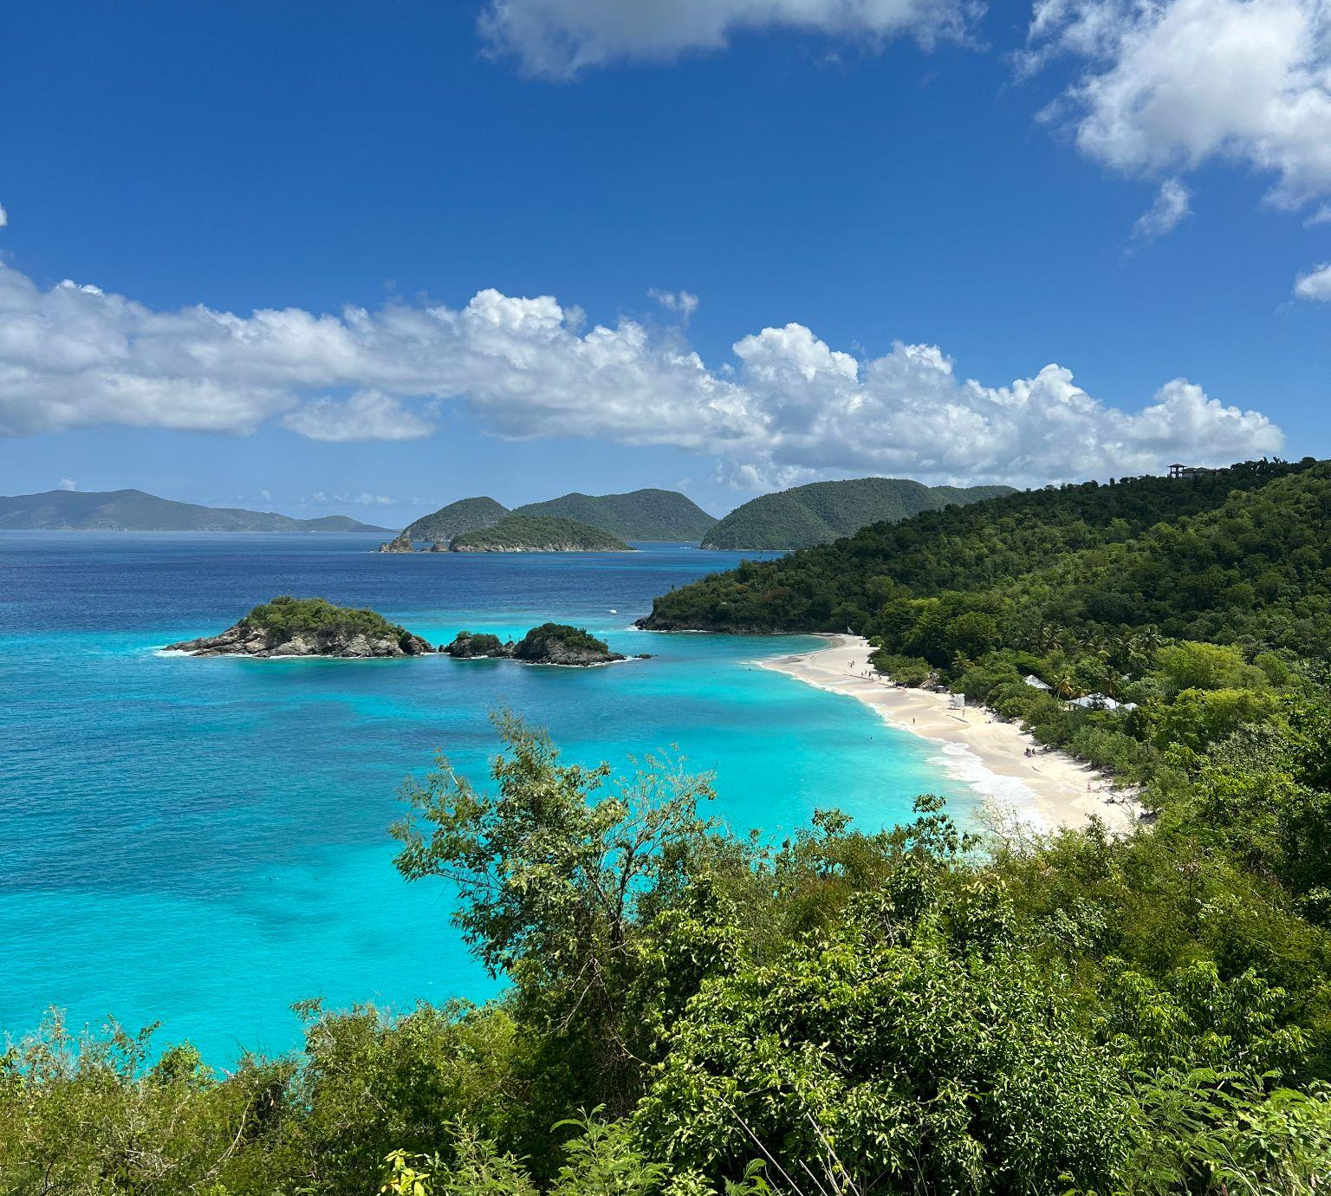
In this era, the changing climate is producing more, and more intense, disaster impacts. From wildfires to hurricanes to flooding, federal government response is stretched thin. In 2023, the United States experienced 28 climate and weather disasters with damages exceeding $1 billion*.
Acknowledging that the changing reality affects the government’s traditional approach to managing risk and recovery, a whole community approach has been embraced to increase the Nation’s resilience by engaging with communities as vital partners.
*NOAA National Centers for Environmental Information (NCEI) U.S. Billion-Dollar Weather and Climate Disasters (2024). https://www.ncei.noaa.gov/access/billions/, DOI: 10.25921/stkw-7w73
Notes:
Getting back to the topic at hand, the Anthropocene is an unofficial unit of geologic time used to describe the most recent period in Earth’s history, when human activity began to have a significant impact on the planet’s climate and ecosystems. This era has produced more, and more intense, climate-fueled disaster impacts. In 2023, the United States experienced 28 climate and weather disasters with damages exceeding $1 billion. Within this context, federal resources are routinely stretched thin across too many simultaneous and consecutive disasters.
In a correlated pivot in approach, FEMA has, over the past dozen years, undertaken a shift towards a whole community approach to emergency management. Acknowledging that the changing reality affects the government’s traditional approach to managing risk and recovery, a whole community approach has been embraced to increase the Nation’s resilience by engaging with communities as vital partners.

Slide 7
Challenges for a Whole Community Approach
What is a community?
Social capital within the context of resilience
Systemic inequities in recovery
Barriers to sharing and learning from community knowledge,
Notes:
To fully unlock the power of the whole community approach, however, we must grapple with several issues, including the conceptualization of “community”, the value of social capital in relation to resilience, the systemic inequities too often present in recovery, and the ways that disparate communities can connect in blue skies to share lessons learned.
Undoubtedly, the cache of community knowledge that is generated post-disaster is incredibly valuable. Part of the role of information and communication in community preparedness is to protect and preserve this cache. However, most often this knowledge is gained in the aftermath. The longer we aren’t prioritizing the collection, cataloging, and dispersal of communities’ data and anecdotal evidence, the longer we are missing an opportunity to massively leverage community experience.
The term social capital recognizes the networks of relationships among people who live and work in a community, enabling it to function effectively. Though we say “don’t trade business cards in a disaster”, the truth is that often a disaster throws these relationships into stark relief, building bridges and changing social dynamics. The question is, how can communities build these relationships more effectively before a disaster?
The whole community approach, in broad strokes, is intended to strengthen what is already working within communities, but the connection between local and federal government resources and community grassroots initiatives is still very much a work in progress. In the aftermath of any given disaster, community-led efforts can often be the most striking, whether through nonprofits, faith-based initiatives, or mutual aid. But too often these efforts falter and fail while waiting for concrete public-private partnerships and funding to materialize.
I’m going to turn it over to our panel now to discuss their respective roles in community readiness, and then we’ll move into a panel discussion followed by time for some questions from y’all.

Slide 8
State of
Local Emergency Response
Scope of Responsibility, Staffing Constraints, and Unmet Needs
Supporting Role of Community Organizations and Private Sector
Three Islands, Two Districts
Meeting the needs of multiple physically disparate communities
Regina Browne
VITEMA

Slide 9
State of
Local Human Services Response
ESF #6 Mass Care
Sheltering
PODs
Senior Services
Identifying Supporting Partners and Sharing the Burden of Care
Yvette Henry
VI Department of Human Services

Slide 10
Community-Led Preparedness
Developing and cultivating local relationships
Faith Leaders
Local Government
Private Sector
Capacity building in the community
Training
Outreach
Delia Richardson
Virgin Islands VOAD

Slide 11
Evolving Role of the Private Sector
Challenges to Public-Private Partnerships
Developing the BEOCs
Business Emergency Operations Centers (BEOCs)

Slide 12
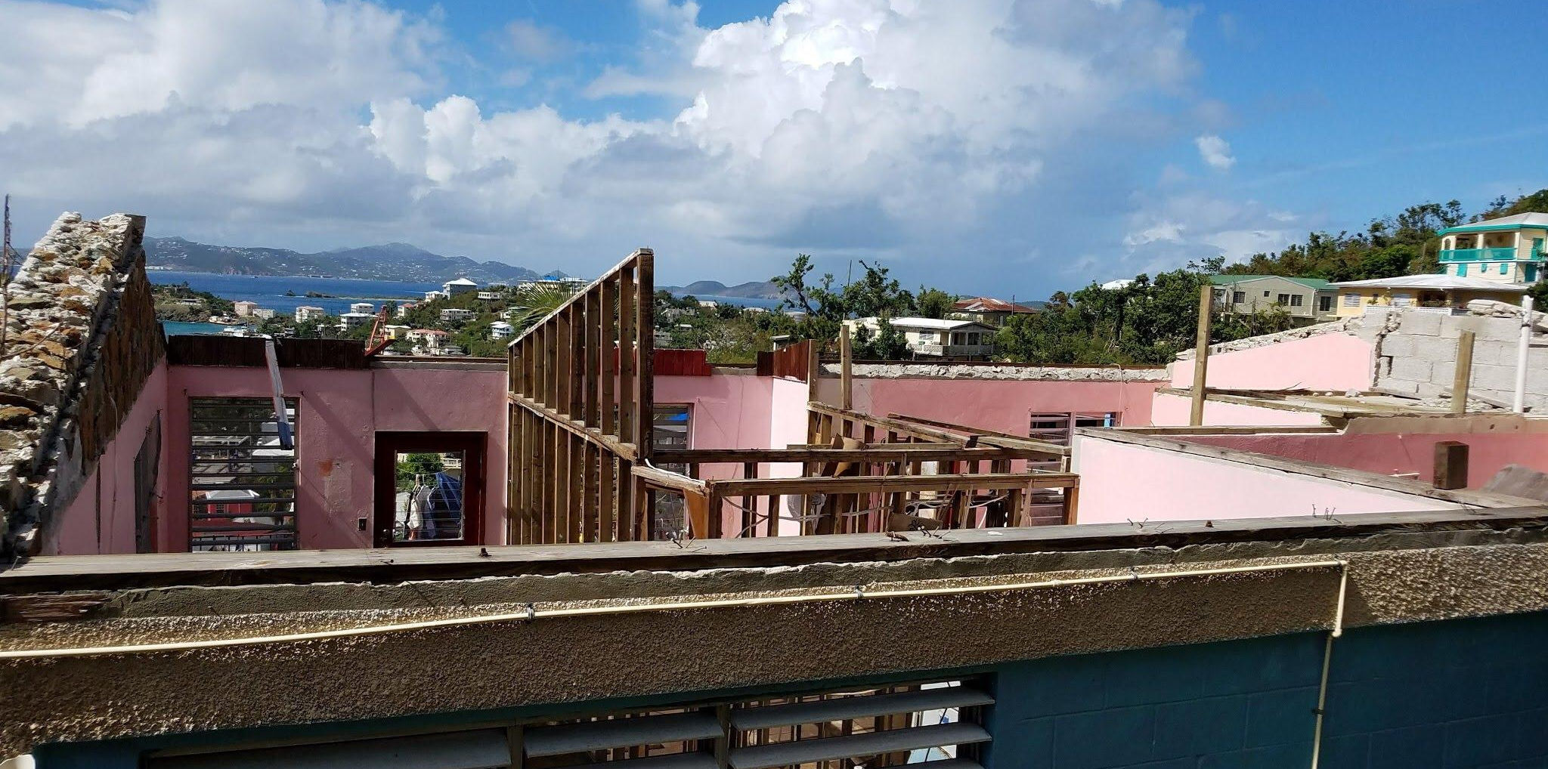
Question :
Communities in the aftermath of disaster often find that not only are their homes and livelihoods destroyed, but that systemic inequities and long-standing social crises are unearthed and exacerbated. How can communities leverage preparedness to lessen these impacts?
Notes:
Now that we’ve contextualized the panel and our respective roles, I have some questions for the group!
(Start with Delia, then Regina)

Slide 13
Question :
Mitigation and preparedness are deeply linked. How can governments, communities, and the private sector best collaborate to generate proactive, relevant mitigation and preparedness projects?
Notes:
(Start with Regina, then Wilbur)

Slide 14
Question :
Increasingly, the value of “good data” is becoming clear as part of community preparedness. How do you see your role - as government, community organization, or private sector - in developing and applying “good data”?
Notes:
(Start with Yvette - in the context of identifying vulnerable populations, then Delia, then Regina)
Thanks so much to our panel for this discussion!
It’s a commonly held opinion these days that the scale and severity of disasters are growing and will likely pose systemic threats, while simultaneously accelerating changes in demographics and technology will continue to make the effects of disasters more complex to manage. This doesn’t just mean more disasters for communities that have been impacted in the past, it also means more communities devastated by historically unprecedented events. Federal, local, and state government resources are already strained, and this trend will only continue. Community-led preparedness is the logical gap-filler, with prepared communities bringing valuable knowledge of their social capital to the table. As we navigate the longstanding history of systemic inequity present in so many community-government partnerships, we must understand the landscape of preexisting networks, and identify leaders who can understand and communicate community needs, and also bridge the gap between those communities who’ve lived a disaster and those communities who simply haven’t yet.
On that note, I’m happy to open the floor to any questions!
(next slide)

Slide 15
Audience Q&A

Slide 16
Contact Information
Meaghan Enright | Executive Director, Love City Strong
meaghan@lovecitystrongvi.org
Regina Browne | Deputy Director of Planning & Preparedness, VITEMA
Regina.Browne@vitema.vi.gov
Yvette Henry | VI Department of Human Services
yvette.henry@dhs.vi.gov
Delia Richardson | Executive Director, Virgin Islands VOAD
edce@stxltrg.org
Wilbur Francis | Director, Department of Licensing & Consumer Affairs
wilbur.francis@dlca.vi.gov

